Slide 1
Crypto Investment Fund Directory
WANG CHUN

Slide 2
Introduction
2018 Directory of Cryptocurrency Investment Funds
This dataset is a directory of known crypto funds and includes names and contact information.

Slide 3

Source

Slide 4
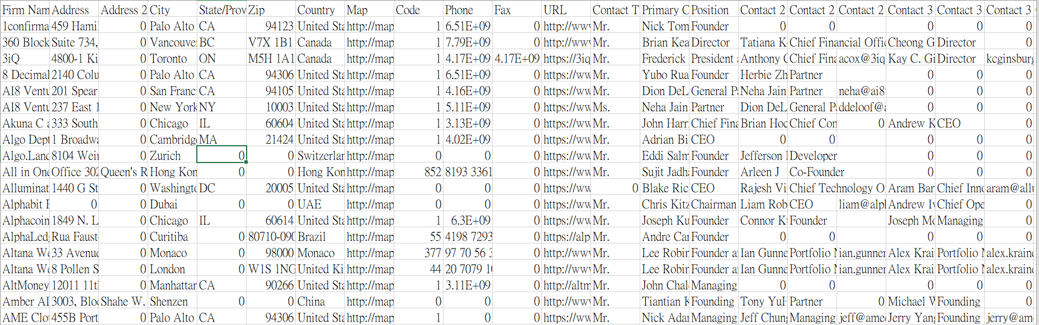
Dataset overview

Slide 5
Important info
Country (EX: Canada,United States...)
AUM (Millions) (EX: 10,20,30...)
Professional Staff (EX: 3,4,5...)
Founded (EX: 2015,2016,2017...)
Firm Type (EX: Hedge Fund,Venture...)
SEC Registered? (YES or NO)
Investments (this company invest some other platform or companies)(company names)
Position(Founder,Director,CEO...)
Form of Incorporation(Corporation,Limited Liability Company...)

Slide 6
Process
Exploratory analysis progress
Data munging
Visualizing and searching for patterns
Building a Predictive Model -- Decision Tree

Slide 7
expectation
Understand the companies Founded time in a specific country
The relationship of AUM and Professional Staff
The relationship of high AUM companies and Form of Incorporation
The specific Investment company analysis

Slide 8
Exploratory analysis progress
Get sum of AUM (Millions)
Get pivot table of 'SEC Registered?'

Slide 9
Data munging
Check 'SEC Registered?' missing values
Address this data

Slide 10


Get the 'SEC Registered?’ values exist
We can know that we can fill NO into the missing value

Slide 11

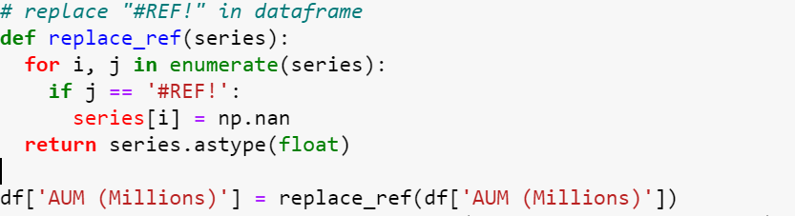
weird values

Slide 12
extreme values
Use log function

Slide 13
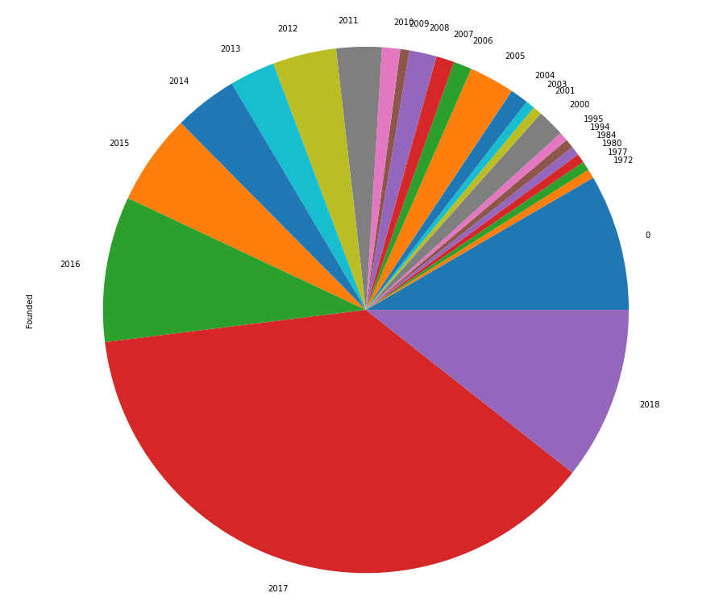
1. Understand the companies Founded time in a specific country
Country: US
In the US, most of the companies in the dataset founded in 2017, and there are still some old companies participate in crypto investment

Slide 14
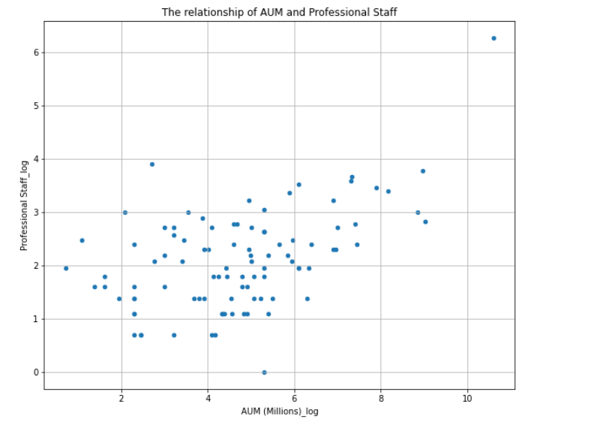
2. The relationship of AUM and Professional Staff
From the chart, we can see that the relationship of AUM and Professional Staff are roughly proportional

Slide 15
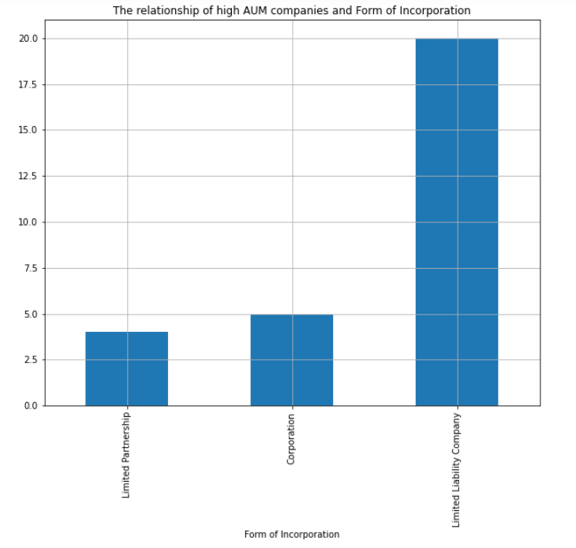
3. The relationship of high AUM companies and Form of Incorporation
high AUM : > AUM_companies_mean
The high AUM companies are almost Limited Liability Company, and the number of Limited Partnership and Corporation companies are almost same.

Slide 16
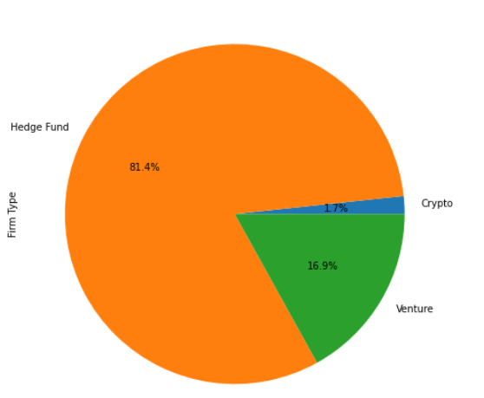
4.The specific Investment company analysis
Company : Ethereum
For the companies which invest ethereum, almost all of them are Firm Type

Slide 17
Building a Predictive Model -- Decision Tree
outcomes = ['AUM (Millions)_log','Professional Staff_log','Founded’]
predictors = ['AUM (Millions)_log','Professional Staff_log','Founded']

Slide 18
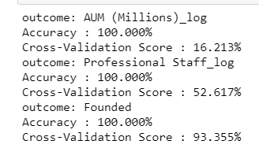
Result
from the result , we can know that use Founded as outcome can be most correct

